Slide 1
Module 3
Building AI Agents with AutoGen

Slide 2
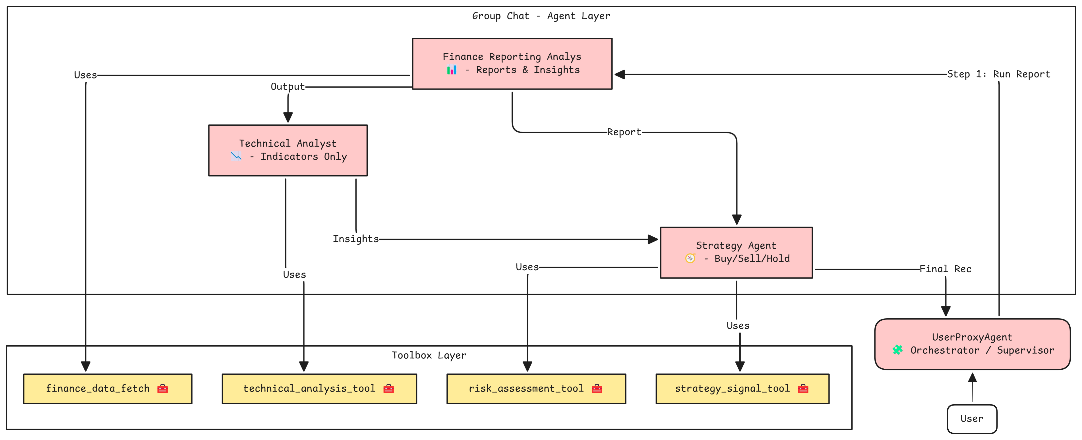
Agents and Tools for Financial Analysis

Slide 3
Agent 1 – Finance Reporting Analyst
Role: Generate markdown-based financial reports from stock data
Responsibilities:
Fetch data via tools
Compute financial metrics, ratios
Create initial analysis report in a markdown format
Constraints: No hallucinations, must reflect uncertainty
Tool Used: finance_data_fetch

Slide 4
Tool 1: finance_data_fetch
Purpose: Fetch basic financial and historical stock data
Inputs: stock ticker, period (optional, default = 1mo)
Metrics Extracted:
Company info (name, market cap, price, ratios)
Historical closing prices
Used by: finance_reporting_analyst
Error Handling: Graceful fallback with error message in JSON
{
"name": "finance_data_fetch",
"data": {
"name": "Apple Inc.",
"symbol": "AAPL",
"currentPrice": 192.32,
"currency": "USD",
"summary": "Apple Inc. designs, manufactures, and markets smartphones, personal computers, tablets...",
"marketCap": 3000000000000,
"peRatio": 29.87,
"priceToBook": 45.3,
"dividend": 0.92,
"recentClosePrices": {
"2024-06-01": 189.50,
"2024-06-02": 190.40,
"2024-06-03": 191.70,
"2024-06-04": 192.32
}
}
}
Notes:
When to Plan Agent Roles:
Before coding orchestration logic
When multiple skills/tools are involved
When output requires sequential reasoning or aggregation
During architecture design of multi-agent systems

